Slide 1
Murach’s PHP and MySQL (4th Edition)
Chapter 15
How to use regular expressions, handle exceptions, and validate data

Slide 2
Applied objectives
Create and use regular expressions.
Create and throw exceptions.
Catch and handle exceptions and errors.

Slide 3
Knowledge objectives
Describe the creation of a regular expression and the processing that’s done by the preg_match() function.
Describe the use of case-insensitive, multiline, and global regular expressions.
Describe the use of the preg_replace() and preg_split() functions that work with regular expressions.
Describe how regular expressions can be used for data validation such as validating a social security number.
Describe how the filter_var() function can be used for data validation such as validating an email address.
Describe the way exceptions are created, thrown, and handled.
Describe the type of errors that PHP 7 and later let you catch and how you catch and handle them.

Slide 4
A function for matching a regular expression
preg_match($pattern, $string)
How to create a regular expression
$pattern = '/Harris/';
Two strings to test
$author = 'Ray Harris';
$editor = 'Joel Murach';
How to search for the pattern
$author_match = preg_match($pattern, $author);
// $author_match is 1
$editor_match = preg_match($pattern, $editor);
// $editor_match is 0

Slide 5
How to test for errors in a regular expression
if ($author_match === false) {
echo 'Error testing author name.';
} else if ($author_match === 0) {
echo 'Author name does not contain Harris.';
} else {
echo 'Author name contains Harris.';
}

Slide 6
A case-insensitive regular expression
$pattern = '/murach/i';
How to use a case-insensitive regular expression
$editor_match = preg_match($pattern, $editor);
// $editor_match is 1

Slide 7
Patterns for special characters
Pattern | Matches
\\ | Backslash character
\/ | Forward slash
\t | Tab
\n | New line
\r | Carriage return
\f | Form feed
\xhh | The Latin-1 character whose value is the two hexadecimal digits

Slide 8
Matching special characters
$string =
"© 2022 Mike's Music. \ All rights reserved (5/2022).";
preg_match('/\xA9/', $string)
// Matches © and returns 1
preg_match('///', $string)
// Returns FALSE and issues a warning
preg_match('/\//', $string)
// Matches / and returns 1
preg_match('/\\\\/', $string)
// Matches \ and returns 1

Slide 9
Patterns for character types
Pattern | Matches
. | Any single character except a new line character (use \. to match a period)
\w | Any letter, number, or the underscore
\W | Any character that’s not a letter, number, or the underscore
\d | Any digit
\D | Any character that’s not a digit
\s | Any whitespace character (space, tab, new line, carriage return, form feed, or vertical tab)
\S | Any character that’s not whitespace

Slide 10
Matching character types
$string = 'The product code is MBT-3461.';
preg_match('/MB./', $string)
// Matches MBT and returns 1
preg_match('/MB\d/', $string)
// Matches nothing and returns 0
preg_match('/MBT-\d/', $string)
// Matches MBT-3 and returns 1

Slide 11
Pattern for a character class
Pattern | Matches
[chars] | A single character that is listed inside the brackets (use \[ or \] to match a bracket)
Using the character class
$string = 'The product code is MBT-3461.';
preg_match('/MB[TF]/', $string)
// Matches MBT and returns 1
preg_match('/[.]/', $string)
// Matches . and returns 1
preg_match('/[13579]/', $string)
// Matches 3 and returns 1

Slide 12
Metacharacters inside a character class
Character | Meaning
^ | Negates the list of characters inside the character class
- | Creates a range of characters based on their Latin-1 character set values

Slide 13
Using metacharacters
$string = 'The product code is MBT-3461.';
preg_match('/MB[^TF]/', $string)
// Matches nothing and returns 0
preg_match('/MBT[^^]/', $string)
// Matches MBT- and returns 1
preg_match('/MBT-[1-5]/', $string)
// Matches MBT-3 and returns 1
preg_match('/MBT[_*-]/', $string)
// Matches MBT- and returns 1

Slide 14
Patterns for bracket expressions in a character class
Pattern | Matches
[:digit:] | Digits (same as \d)
[:lower:] | Lowercase letters
[:upper:] | Uppercase letters
[:letter:] | Upper- and lowercase letters
[:alnum:] | Upper- and lowercase letters and digits
[:word:] | Upper- and lowercase letters, digits, and the underscore (same as \w)
[:print:] | All printable characters including the space
[:graph:] | All printable characters excluding the space
[:punct:] | All printable characters excluding letters and digits

Slide 15
Using bracket expressions
$string = 'The product code is MBT-3461.';
preg_match('/MBT[[:punct:]]/', $string)
// Matches MBT- and returns 1
preg_match('/MBT[[:digit:]]/', $string)
// Matches nothing and returns 0
preg_match('/MB[[:upper:]]/', $string)
// Matches MBT and returns 1

Slide 16
Key terms for regular expressions
regular expression
pattern
escape character
metacharacter
character class
bracket expression

Slide 17
How to match string positions
Pattern | Matches
^ | The beginning of the string (use \^ to match a caret)
$ | The end of the string (use \$ to match a dollar sign)
\b | The beginning or end of a word (must not be inside brackets)
\B | A position other than the beginning or end of a word

Slide 18
Matching string positions
$author = 'Joel Murach';
preg_match('/^Joel/', $author)
// Returns 1
preg_match('/Murach$/', $author)
// Returns 1
preg_match('/^Murach/', $author)
// Returns 0
preg_match('/\bJoe/', $editor)
// Returns 1
preg_match('/Joe\b/', $editor)
// Returns 0

Slide 19
How to group and match subpatterns
Pattern | Matches
(subpattern) | Creates a numbered subpattern group (use \( and \) to match a parenthesis)
(?:subpattern) | Creates an unnumbered subpattern group
| | Matches either the left or right subpattern
\n | Matches a numbered subpattern group
Matching subpatterns
$name = 'Rob Robertson';
preg_match('/^(Rob)|(Bob)\b/', $name)
// Returns 1
preg_match('/^(\w\w\w) \1/', $name)
// Returns 1

Slide 20
How to match a repeating subpattern
Pattern | Matches
{n} | Pattern must repeat exactly n times (use \{ and \} to match a brace)
{n,} | Pattern must repeat n or more times
{n,m} | Subpattern must repeat from n to m times
? | Zero or one of the previous subpattern (same as {0,1})
+ | One or more of the previous subpattern (same as {1,})
* | Zero or more of the previous subpattern (same as {0,})

Slide 21
Matching repeating patterns
$phone = '559-555-6627';
preg_match('/^\d{3}-\d{3}-\d{4}$/', $phone)
// Returns 1
$fax = '(559) 555-6635';
preg_match('/^\(\d{3}\) ?\d{3}-\d{4}$/', $fax)
// Returns 1
$phone_pattern =
'/^(\d{3}-)|(\(\d{3}\) ?)\d{3}-\d{4}$/';
preg_match($phone_pattern, $phone)
// Returns 1
preg_match($phone_pattern, $fax)
// Returns 1
$items = 'MBT-6745, MBS-5729 MBT-6824';
preg_match('/[, ]+/', $items);
// Returns 1

Slide 22
Patterns for assertions
Pattern | Meaning
(?=assertion) | Creates a look-ahead assertion
(?!assertion) | Creates a negative look-ahead assertion
Look-ahead assertions
(?=[[:digit:]])
// The next character in the string must be a digit
(?=.*[[:digit:]])
// The string must contain at least one digit
Notes:
https://www.php.net/manual/en/regexp.reference.assertions.php#:~:text=Lookahead%20assertions%20start%20with%20%28%3F%3D%20for%20positive%20assertions,of%20%22foo%22%20that%20is%20not%20followed%20by%20%22bar%22.

Slide 23
A look-ahead assertion
$pattern = '/^(?=.*[[:digit:]])[[:alnum:]]{6}$/';
preg_match($pattern, 'Harris')
// Assertion fails and returns 0
preg_match($pattern, 'Harri5')
// Matches and returns 1
A negative look-ahead assertion
$pattern = '/^(?!3[2-9])[0-3][[:digit:]]$/';
preg_match($pattern, '32')
// Assertion fails and returns 0
preg_match($pattern, '31')
// Matches and returns 1

Slide 24
A pattern to enforce password complexity
$pw_pattern =
'/^(?=.*[[:digit:]])(?=.*[[:punct:]])[[:print:]]{6,}$/';
The parts of the pattern
^ // start of the string
(?=.*[[:digit:]]) // at least one digit
(?=.*[[:punct:]]) // at least one punctuation character
[[:print:]]{6,} // six or more printable characters
$ // nothing else
Using the pattern
$password1 = 'sup3rsecret';
$password2 = 'sup3rse(ret';
preg_match($pw_pattern, $password1)
// Assertion fails and returns 0
preg_match($pw_pattern, $password2)
// Matches and returns 1

Slide 25
How to work with a multiline regular expression
$string = "Ray Harris\nAuthor";
$pattern1 = '/Harris$/';
preg_match($pattern1, $string);
// Does not match Harris and returns 0
$pattern2 = '/Harris$/m';
preg_match($pattern2, $string);
// Matches Harris and returns 1

Slide 26
A function to find multiple matches in a string
preg_match_all($pattern, $string, $matches)
How to work with a global regular expression
$string = 'MBT-6745 MBT-5712';
$pattern = '/MBT-[[:digit:]]{4}/';
$count = preg_match_all($pattern, $string, $matches); // Count is 2
foreach ($matches[0] as $match) {
echo '<div>' . $match . '</div>';
// Displays MBT-6745 and MBT-5712
}

Slide 27
Two more functions for regular expressions
preg_replace($pattern, $new, $string)
preg_split($pattern, $string)

Slide 28
How to use the preg_replace() function to replace a pattern with a string
$items = 'MBT-6745 MBS-5729';
$items = preg_replace('/MB[ST]/', 'ITEM', $items);
echo $items; // Displays ITEM-6745 ITEM-5729

Slide 29
How to use the preg_split() function to split a string on a pattern
$items = 'MBT-6745 MBS-5729, MBT-6824, and MBS-5214';
$pattern = '/[, ]+(and[ ]*)?/';
$items = preg_split($pattern, $items);
// $items contains:
// 'MBT-6745', 'MBS-5729', 'MBT-6824', 'MBS-5214'
foreach ($items as $item) {
echo '<li>' . $item . '</li>';
}

Slide 30
Regular expressions for testing validity
Phone numbers in this format: 999-999-9999
/^[[:digit:]]{3}-[[:digit:]]{3}-[[:digit:]]{4}$/
Credit card numbers in this format: 9999-9999-9999-9999
/^[[:digit:]]{4}(-[[:digit:]]{4}){3}$/
Zip codes in either of these formats: 99999 or 99999-9999
/^[[:digit:]]{5}(-[[:digit:]]{4})?$/
Dates in this format: mm/dd/yyyy
/^(0?[1-9]|1[0-2])\/(0?[1-9]|[12][[:digit:]]|3[01])\/
[[:digit:]]{4}$/ // on one line with no spaces

Slide 31
Test a phone number for validity
$phone = '559-555-6624';
$phone_pattern =
'/^[[:digit:]]{3}-[[:digit:]]{3}-[[:digit:]]{4}$/';
$match = preg_match($phone_pattern, $phone);
// Returns 1

Slide 32
Test a date for a valid format, but not for a valid month, day, and year
$date = '8/10/209'; // Invalid date
$date_pattern = '/^(0?[1-9]|1[0-2])\/'
. '(0?[1-9]|[12][[:digit:]]|3[01])\/'
. '[[:digit:]]{4}$/';
$match = preg_match($date_pattern, $date);
// Returns 0

Slide 33
A PHP function for data validation
filter_var($value, $filter)
Common constants for validation filters
FILTER_VALIDATE_EMAIL
FILTER_VALIDATE_URL
A function that validates an email address
function valid_email($email) {
if (filter_var($email, FILTER_VALIDATE_EMAIL)) {
return true;
} else {
return false;
}
}

Slide 34
The syntax for creating a new Exception object
new Exception($message [, $code])
The syntax for the throw statement
throw $exception;

Slide 35
A function that may throw an exception
function calculate_future_value(
$investment, $interest_rate, $years) {
if ($investment <= 0 || $interest_rate <= 0 ||
$years <= 0 ) {
throw new Exception(
"All arguments must be greater than zero.");
}
$future_value = $investment;
for ($i = 1; $i <= $years; $i++) {
$future_value += $future_value *
$interest_rate * .01;
}
return round($future_value, 2);
}
A statement that causes an exception
$futureValue = calculate_future_value(10000, 0.06, 0);

Slide 36
Methods of Exception objects
getMessage()
getCode()
getFile()
getLine()
getTrace()
getTraceAsString()

Slide 37
The syntax for a try/catch statement
try { statements }
catch (ExceptionClass $exceptionName) { statements }
[ catch (ExceptionClass $exceptionName) { statements } ] ...
A statement that catches an Exception object
try {
$fv = calculate_future_value(10000, 0.06, 0);
echo 'Future value is ' . $fv;
} catch (Exception $e) {
echo Exception: ' . $e->getMessage();
}

Slide 38
A statement that re-throws an Exception object
try {
$fv = calculate_future_value(
$investment, $annual_rate, $years);
} catch (Exception $e) {
throw $e;
}
A statement that catches two types of exceptions
try {
$db = new PDO($dsn, 'mmuser', 'pa55word', $options);
// other statements
} catch (PDOException $e) {
echo 'PDOException: ' . $e->getMessage();
} catch (Exception $e) {
echo 'Exception: ' . $e->getMessage();
}

Slide 39
Code that catches all errors and exceptions
try {
$fv = calc_future_value(10000, 0.06, 9); // Error
} catch (Exception $e) {
echo 'Error: ' . $e->getMessage();
} catch (Error $e) {
echo 'Error: ' . $e->getMessage();
}
The message for the error above
Error: Call to undefined function calc_future_value()
A more concise way to catch all errors
and exceptions
try {
$fv = calculate_future_value(10000, 0.06, 9);
} catch (Throwable $e) {
echo 'Error: ' . $e->getMessage();
}

Slide 40
Code that catches a ParseError
try {
require 'calculations.php';
} catch (ParseError $e) {
echo 'Required file not included: ' .
$e->getMessage();
}
The message for the error above
Required file not included: syntax error, unexpected '}', expecting ';'

Slide 41
Code that catches a TypeError
try {
$average = avg_of_3(5.1, 2.7, 8.2);
} catch (TypeError $e) {
echo 'Error: ' . $e->getMessage();
}
The message for the error above
Error: Argument 1 passed to avg_of_3() must be of the type integer, float given

Slide 42
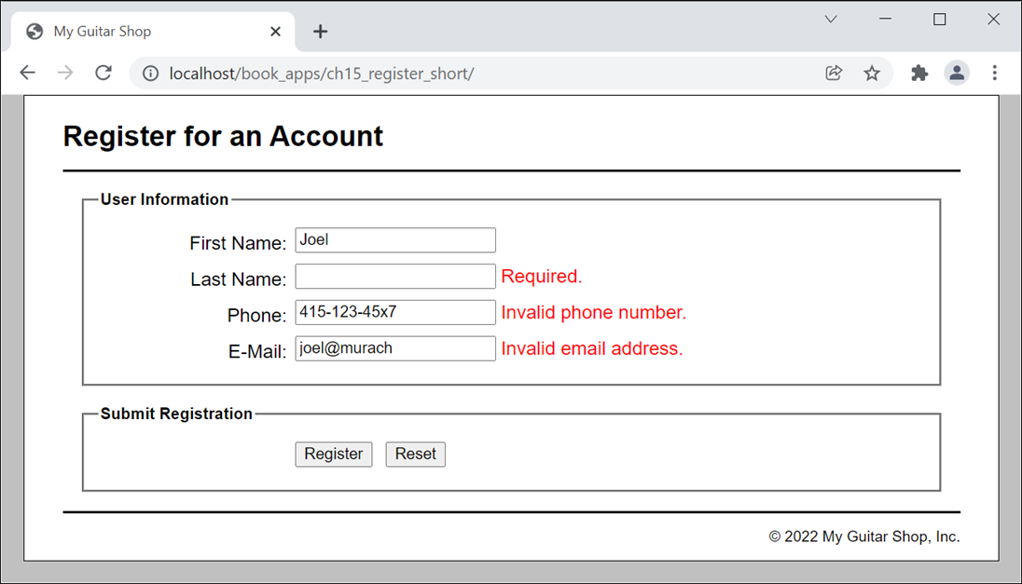
The user interface for the Registration application

Slide 43
The file structure
app_root/
model/
fields.php The Field and Fields classes
validate.php The Validate class
view/
footer.php The HTML and PHP for the footer
header.php The HTML and PHP for the header
register.php The HTML and PHP for the form view
success.php The HTML and PHP for the success view
index.php The PHP for the controller
main.css The CSS for the application

Slide 44
model/fields.php (part 1)
<?php
class Field {
private $hasError = false;
private $value;
public function __construct(
private $name,
private $message = '',
private $required = true,
) { }
public function getName() {
return $this->name; }
public function getMessage() {
return $this->message; }
public function hasError() {
return $this->hasError; }
public function isRequired() {
return $this->required; }
public function isEmpty() {
return empty($this->value); }

Slide 45
model/fields.php (part 2)
public function setValue($value) {
$this->value = $value;
}
public function setErrorMessage($message) {
$this->message = $message;
$this->hasError = true;
}
public function clearErrorMessage() {
$this->message = '';
$this->hasError = false;
}
public function getHTML() {
$message = htmlspecialchars($this->message);
if ($this->hasError()) {
return '<span class="error">' .
$message . '</span>';
} else {
return '<span>' . $message . '</span>';
}
}
}

Slide 46
model/fields.php (part 3)
class Fields {
private $fields = [];
public function addField($name, $message = '',
$required = true) {
$field = new Field($name, $message, $required);
$this->fields[$field->getName()] = $field;
}
public function getField($name) {
return $this->fields[$name];
}
public function hasErrors() {
foreach ($this->fields as $field) {
if ($field->hasError()) { return true; }
}
return false;
}
}
?>

Slide 47
model/validate.php (part 1)
<?php
class Validate {
private $fields;
public function __construct() {
$this->fields = new Fields();
}
public function getFields() {
return $this->fields;
}

Slide 48
model/validate.php (part 2)
// Validate a generic text field
public function text($name, $value, $min = 1, $max = 255) {
// Get Field object and set its value
$field = $this->fields->getField($name);
$field->setValue($value);
// Check field and set or clear error message
if ($field->isRequired() && $field->isEmpty()) {
$field->setErrorMessage('Required.');
} else if (strlen($value) < $min && !$field->isEmpty()) {
$field->setErrorMessage('Too short.');
} else if (strlen($value) > $max) {
$field->setErrorMessage('Too long.');
} else {
$field->clearErrorMessage();
}
return $field;
}

Slide 49
model/validate.php (part 3)
// Validate a field with a generic pattern
public function pattern($name, $value, $pattern, $message) {
// Get Field object and do basic text field check
$field = $this->text($name, $value);
// if OK after text check, move on to pattern check
if (!$field->hasError() && !$field->isEmpty()) {
$match = preg_match($pattern, $value);
if ($match === false) {
$field->setErrorMessage('Error testing field.');
} else if ( $match != 1 ) {
$field->setErrorMessage($message);
} else {
$field->clearErrorMessage();
}
}
}

Slide 50
model/validate.php (part 4)
public function phone($name, $value) {
// Get Field object and do basic text field check
$field = $this->text($name, $value);
// if OK after text check, move on to phone check
if (!$field->hasError() && !$field->isEmpty()) {
// Call pattern method to validate phone number
$pattern =
'/^[[:digit:]]{3}-[[:digit:]]{3}-[[:digit:]]{4}$/';
$message = 'Invalid phone number.';
$this->pattern($name, $value, $pattern, $message);
}
}

Slide 51
model/validate.php (part 5)
public function email($name, $value) {
// Get Field object and do basic text field check
$field = $this->text($name, $value);
// if OK after text check, move on to email check
if (!$field->hasError() && !$field->isEmpty()) {
if (filter_var($value, FILTER_VALIDATE_EMAIL)) {
$field->clearErrorMessage();
} else {
$field->setErrorMessage("Invalid email address.");
}
}
}
}
?>

Slide 52
The controller (index.php) (part 1)
<?php
require_once('model/fields.php');
require_once('model/validate.php');
// Add fields with optional initial message
$validate = new Validate();
$fields = $validate->getFields();
$fields->addField('first_name');
$fields->addField('last_name');
$fields->addField(
'phone', 'Use 888-555-1234 format.', required:false);
$fields->addField('email', 'Must be a valid email address.');
$action = filter_input(INPUT_POST, 'action');
if ($action === NULL) {
$action = 'reset';
} else {
$action = strtolower($action);
}

Slide 53
The controller (index.php) (part 2)
switch ($action) {
case 'reset':
// Reset values for variables
$first_name = '';
$last_name = '';
$phone = '';
$email = '';
// Load view
include 'view/register.php';
break;

Slide 54
The controller (index.php) (part 3)
case 'register':
// Copy form values to local variables
$first_name = trim(filter_input(INPUT_POST, 'first_name'));
$last_name = trim(filter_input(INPUT_POST, 'last_name'));
$phone = trim(filter_input(INPUT_POST, 'phone'));
$email = trim(filter_input(INPUT_POST, 'email'));
// Validate form data
$validate->text('first_name', $first_name);
$validate->text('last_name', $last_name);
$validate->phone('phone', $phone);
$validate->email('email', $email);
// Load appropriate view based on hasErrors
if ($fields->hasErrors()) {
include 'view/register.php';
} else {
include 'view/success.php';
}
break;
}
?>

Slide 55
The view (view/register.php) (part 1)
<?php include 'header.php'; ?>
<main>
<form action="." method="post" >
<fieldset>
<legend>User Information</legend>
<label>First Name:</label>
<input type="text" name="first_name"
value="<?php echo htmlspecialchars($first_name);?>">
<?php echo $fields->getField('first_name')->getHTML(); ?>
<br>
<label>Last Name:</label>
<input type="text" name="last_name"
value= "<?php echo htmlspecialchars($last_name);?>">
<?php echo
$fields->getField('last_name')->getHTML(); ?>
<br>

Slide 56
The view (view/register.php) (part 2)
<label>Phone:</label>
<input type="text" name="phone"
value="<?php echo htmlspecialchars($phone);?>">
<?php echo $fields->getField('phone')->getHTML(); ?><br>
<label>E-Mail:</label>
<input type="text" name="email"
value="<?php echo htmlspecialchars($email);?>">
<?php echo $fields->getField('email')->getHTML(); ?><br>
</fieldset>
<fieldset>
<legend>Submit Registration</legend>
<label>&nbsp;</label>
<input type="submit" name="action" value="Register"/>
<input type="submit" name="action" value="Reset" /><br>
</fieldset>
</form>
</main>
<?php include 'footer.php'; ?>

Slide 57
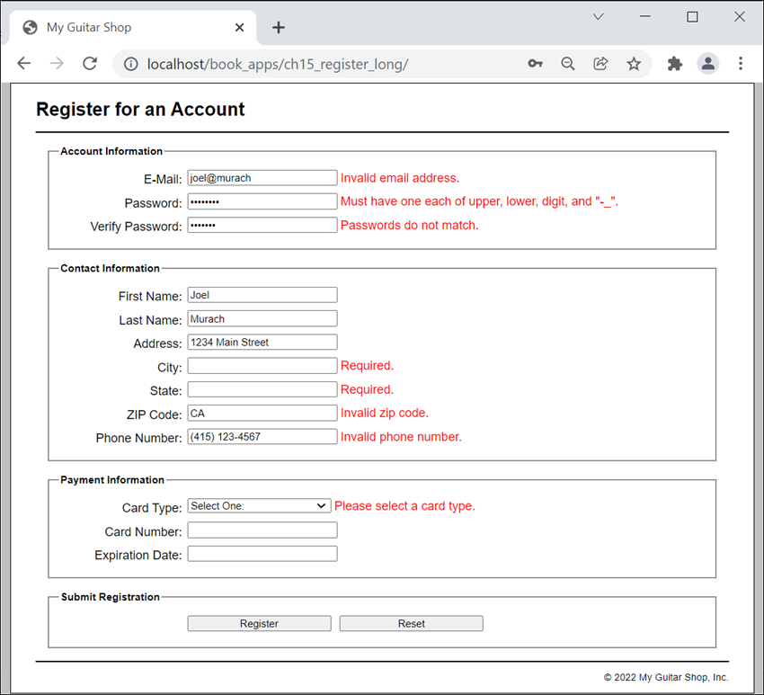
A long version of the Registration application

